Slide 1
Monetary Policy Report
January 2020
    Current economic conditions

Slide 2
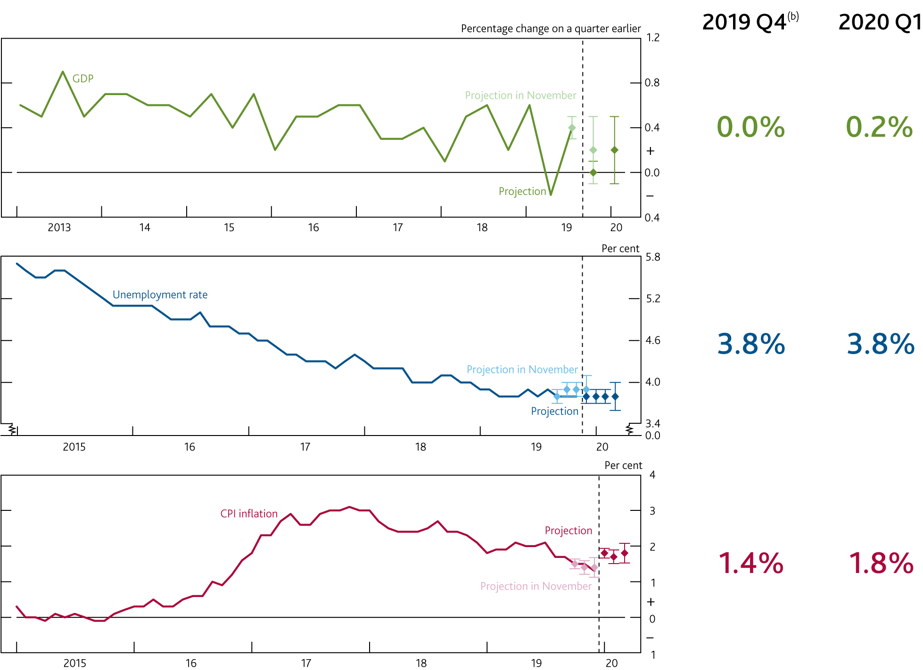
  Chart 2.1 UK GDP growth is expected to remain subdued; inflation is expected to pick up temporarily
    Near-term projections^{(a)}
Sources: ONS and Bank calculations.
The lighter diamonds show Bank staff’s projections at the time of the November 2019 Monetary Policy Report. The darker diamonds show current Bank staff’s projections. The bands on either side of the diamonds show the uncertainty around those projections based on one root mean squared error of projections since 2004.
GDP and unemployment projections are based on official data to November. CPI inflation figure is an outturn.

Slide 3
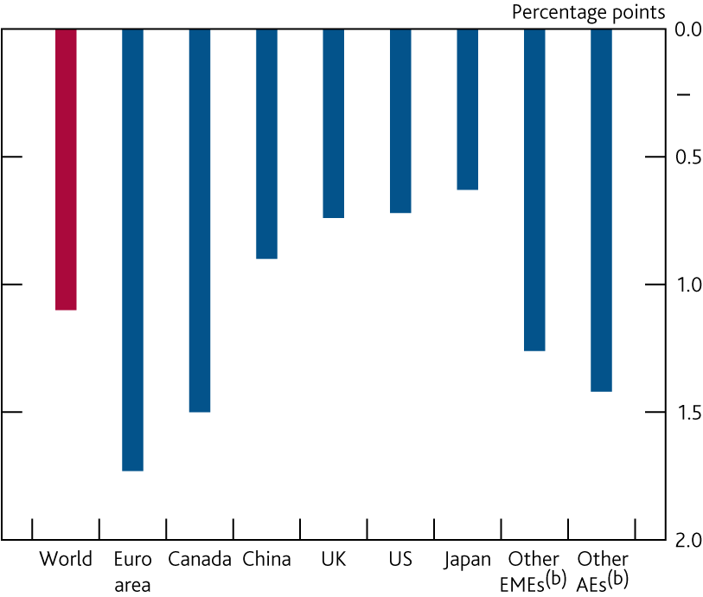
  Chart 2.2 The slowdown in global growth has been broadly based across regions
    Change in four‑quarter GDP growth rates between 2017 Q4 and 2019 Q3^{(a)}
Sources: Eikon from Refinitiv, Eurostat, IMF World Economic Outlook (WEO), Japanese Cabinet Office, National Bureau of Statistics of China, ONS, Statistics Canada, US Bureau of Economic Analysis and Bank calculations.
Chained‑volume measures.
Other EMEs and other advanced economies (AEs) include data for 154 and 11 countries, respectively, as defined by the IMF WEO. Both measures are weighted according to their shares in world GDP, using the IMF’s purchasing power parity (PPP) weights.

Slide 4
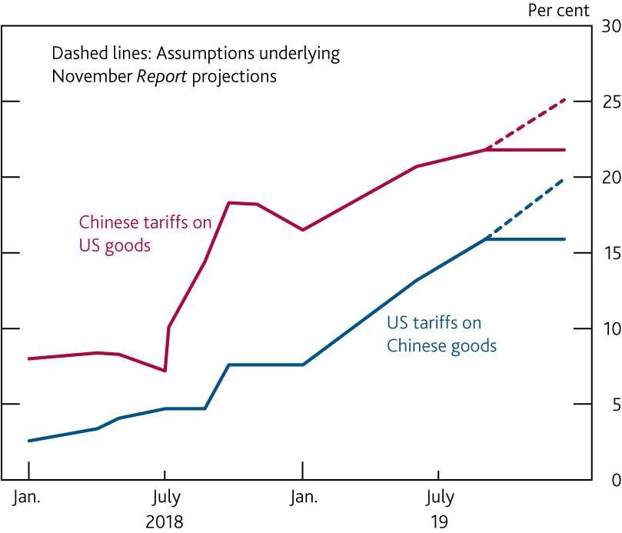
  Chart 2.3 US‑China tariffs are lower than expected in the November Report
    Weighted average tariff rates^{(a)}
Sources: Ministry of Commerce of the People’s Republic of China, Office of the United States Trade Representative and Bank calculations.
Estimates of tariff rates are shown to December 2019.

Slide 5
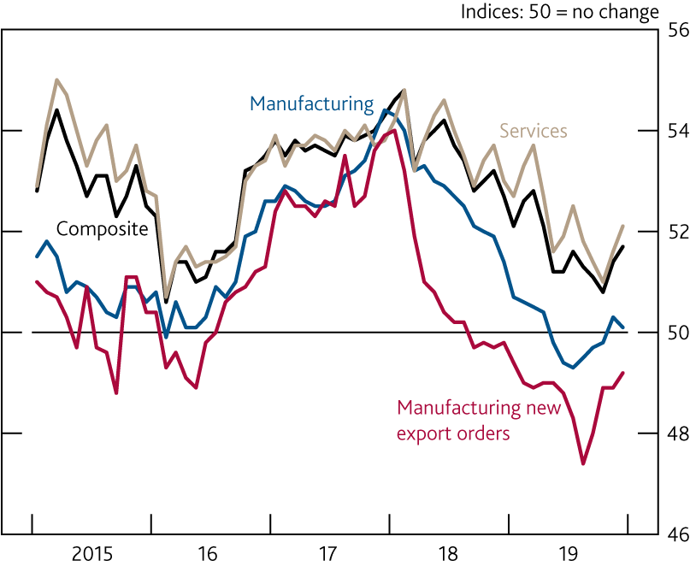
  Chart 2.4 Global PMIs suggest growth is stabilising
    Global purchasing managers’ indices^{(a)}
Sources: Eikon from Refinitiv, IHS Markit and JPMorgan.
Measures of current monthly composite (services and manufacturing) output, manufacturing, services business activity and manufacturing new export orders growth based on the results of surveys in 44 countries. Together these countries account for an estimated 89% of global GDP. Latest data are for December 2019.

Slide 6
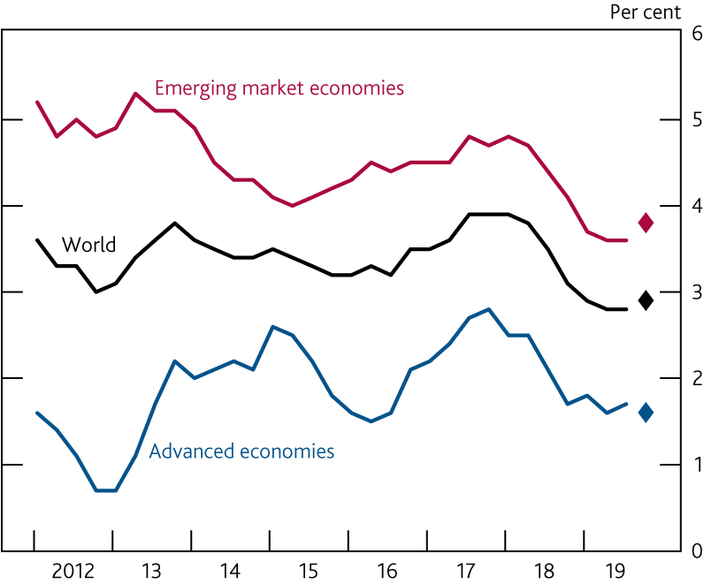
  Chart 2.5 Global growth is expected to pick up slightly in 2019 Q4
    Four-quarter PPP-weighted GDP growth^{(a)}
Sources: Eikon from Refinitiv, IMF WEO and Bank calculations.
Constructed using real GDP growth rates of 189 countries according to their shares in world GDP using the IMF’s PPP weights. Diamonds show Bank staff’s projections for growth in 2019 Q4.

Slide 7
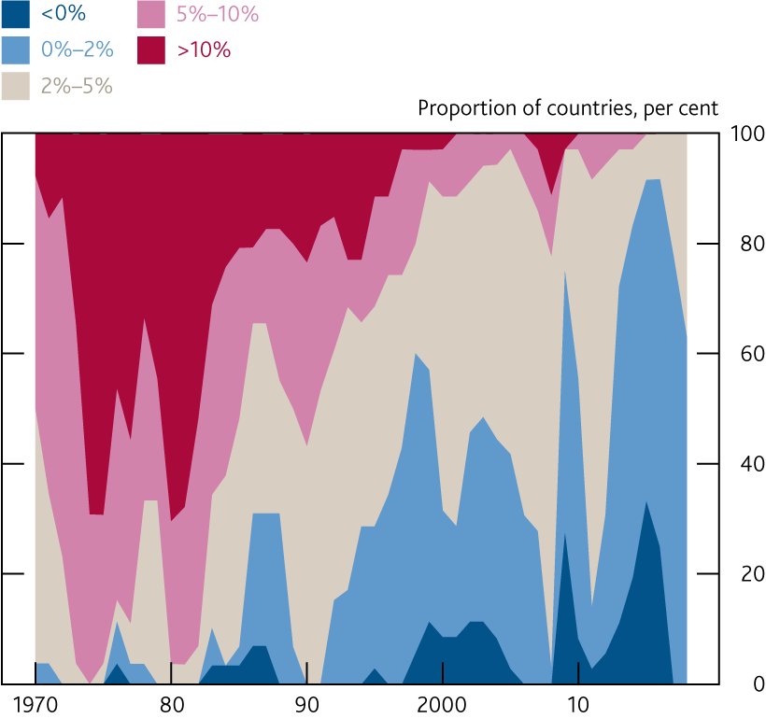
  Chart 2.6 Inflation is subdued across advanced economies
    Annual consumer price inflation across advanced economies^{(a)}
Sources: World Bank: World Development Indicators and Bank calculations.
Consumer prices for 36 advanced economies. Data are available until 2018. Countries with inflation on the bounds of these ranges are placed within the lower range.

Slide 8
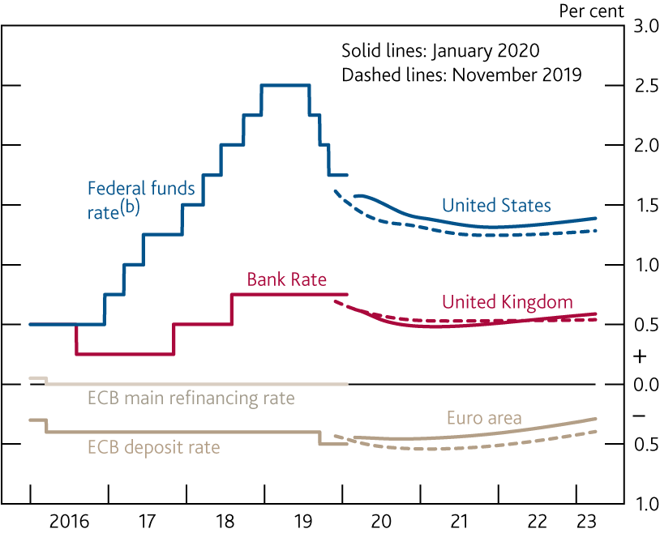
  Chart 2.7 Monetary policy is expected to remain accommodative
    International forward interest rates^{(a)}
Sources: Bloomberg Finance L.P. and Bank calculations.
All data as of 22 January 2020. The January 2020 and November 2019 curves are estimated using instantaneous forward overnight index swap rates in the 15 working days to 22 January 2020 and 30 October 2019 respectively.
Upper bound of the target range.

Slide 9
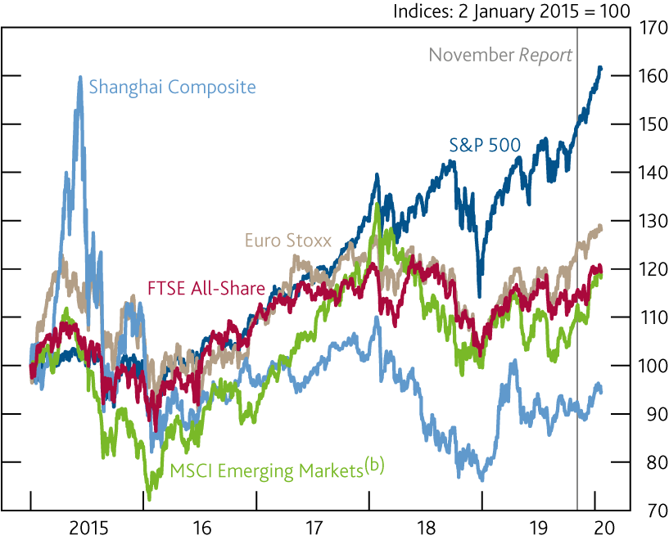
  Chart 2.8 Global equity prices have strengthened as perceived downside risks to growth have declined
    International equity prices^{(a)}
Sources: Eikon from Refinitiv, MSCI and Bank calculations.
In local currency terms, except for MSCI Emerging Markets which is in US dollar terms.
The MSCI Inc. disclaimer of liability, which applies to the data provided, is available from the ‘Download the chart slides and data’ link.

Slide 10
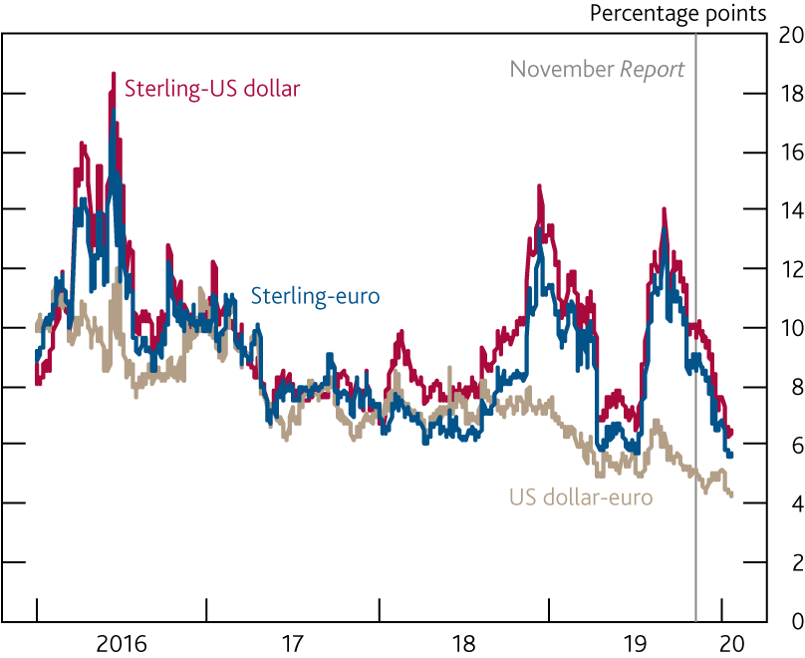
  Chart 2.9 Near‑term sterling implied volatility has fallen considerably
    Three‑month implied volatilities^{(a)}
Sources: Bloomberg Finance L.P. and Bank calculations.
Measures of volatility based on option contracts.

Slide 11
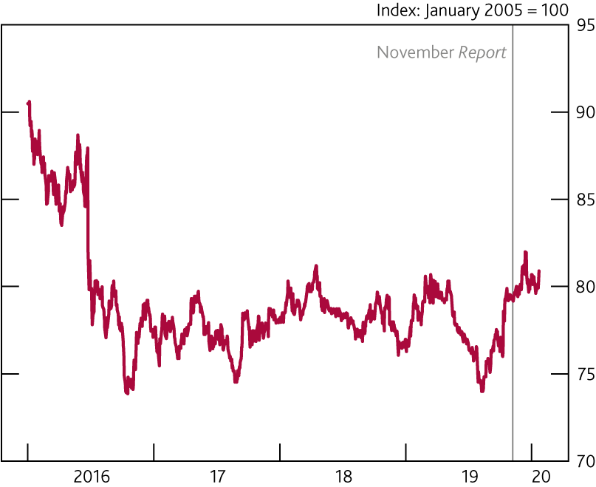
  Chart 2.10 Sterling has appreciated by around 1½% since the November Report
    Sterling ERI

Slide 12
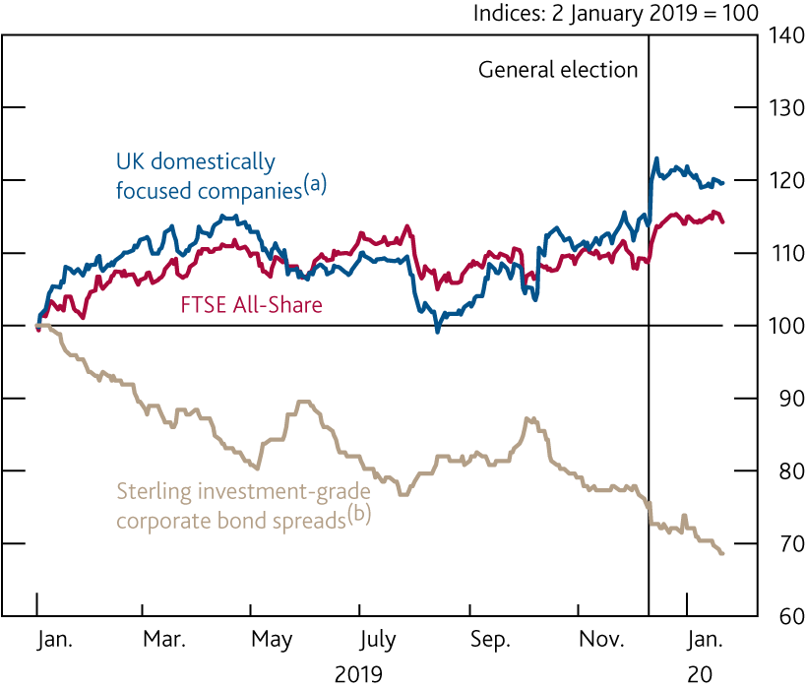
  Chart 2.11 Reduced uncertainty has supported equity prices and lowered bond spreads
    UK equity prices and corporate bond spreads
Sources: Bloomberg Finance L.P., Eikon from Refinitiv, ICE/BoAML Global Research and Bank calculations.
UK domestically focused companies are defined as those generating at least 70% of their revenues in the United Kingdom.
Based on option‑adjusted spreads between government bond yields and non‑financial corporate bonds.

Slide 13
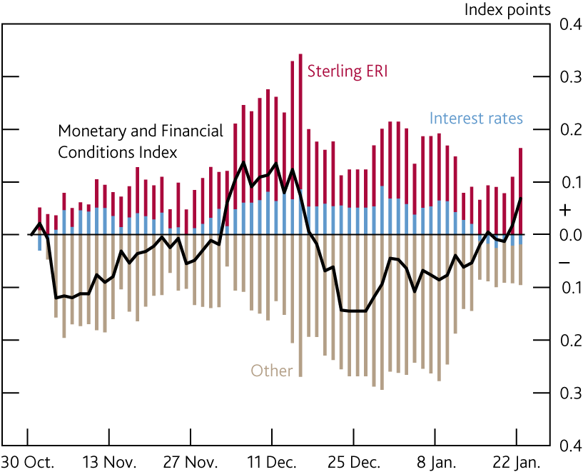
  Chart 2.12 Overall monetary and financial conditions in the UK are broadly unchanged
    Contributions to changes in the UK Monetary and Financial Conditions Index since the November 2019 Report^{(a)}
Sources: Bloomberg Finance L.P., Eikon from Refinitiv, ICE/BoAML Global Research and Bank calculations.
The UK Monetary and Financial Conditions Index (MFCI) summarises information from the following series: short‑term and long‑term interest rates, the sterling ERI, corporate bond spreads, equity prices, and household and corporate bank lending spreads. The series weights are based on the marginal impact of each variable on the UK GDP forecast. The chart shows changes in the MFCI from the average level over the 15 working days to 30 October 2019. An increase in the MFCI signals tighter financial conditions and a decrease signals looser conditions. For more information, see the Bank Overground post ‘How can we measure UK financial conditions?’.

Slide 14
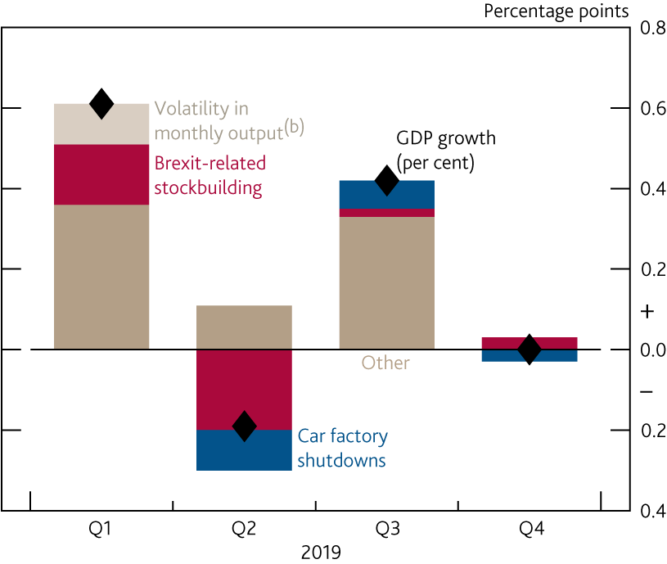
  Chart 2.13 Quarterly GDP growth has been volatile
    Estimated contributions of various factors to quarterly GDP growth^{(a)}
Sources: ONS and Bank calculations.
Chained‑volume measures. 2019 Q4 is Bank staff’s projection. The contributions of idiosyncratic factors are estimated by Bank staff.
GDP fell by 0.4% in December 2018 before rising by 0.6% in January 2019.

Slide 15
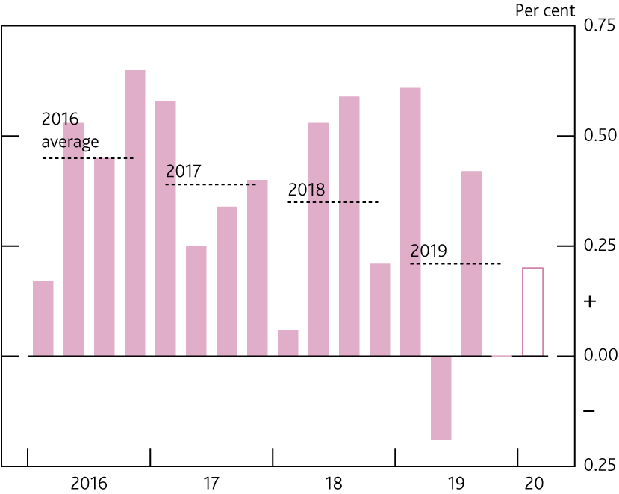
  Chart 2.14 Growth has slowed on average compared to previous years
    Quarterly GDP growth^{(a)}
Sources: ONS and Bank calculations.
Chained‑volume measure. The hollow bars in 2019 Q4 and 2020 Q1 are Bank staff’s projections..

Slide 16
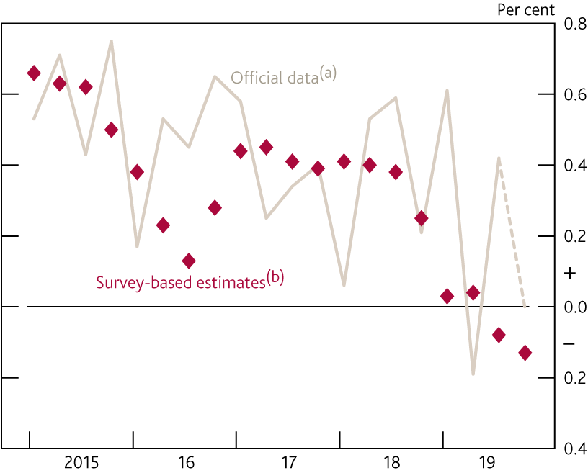
  Chart 2.15 Survey data have suggested a weaker picture for GDP growth in 2019 than official data, similar to 2016
    Quarterly GDP growth and estimates using survey data
Sources: BCC, CBI, IHS Markit/CIPS, Lloyds Banking Group, ONS and Bank calculations.
Dashed lines for GDP growth in 2019 Q4 are Bank staff’s projection.
Survey‑based estimates are Bank staff’s projections for GDP growth using only survey indicators of output and expectations covering the period until the end of the projection quarter.

Slide 17
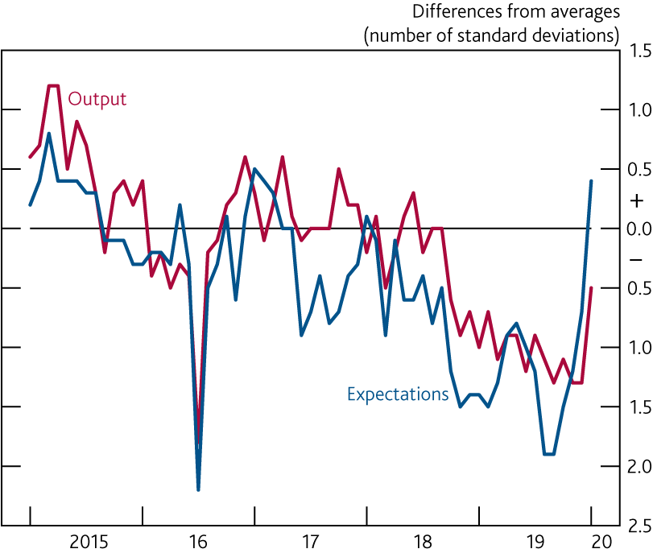
  Chart 2.16 The IHS Markit/CIPS survey output and expectations indices have been weak but picked up markedly in January
    Survey indicators of current and expected output growth^{(a)}
Sources: IHS Markit/CIPS and Bank calculations.
Differences from averages since January 2000. UK composite output and expectations indices. Data for January 2020 are flash estimates with sample period from
13 to 22 January.

Slide 18
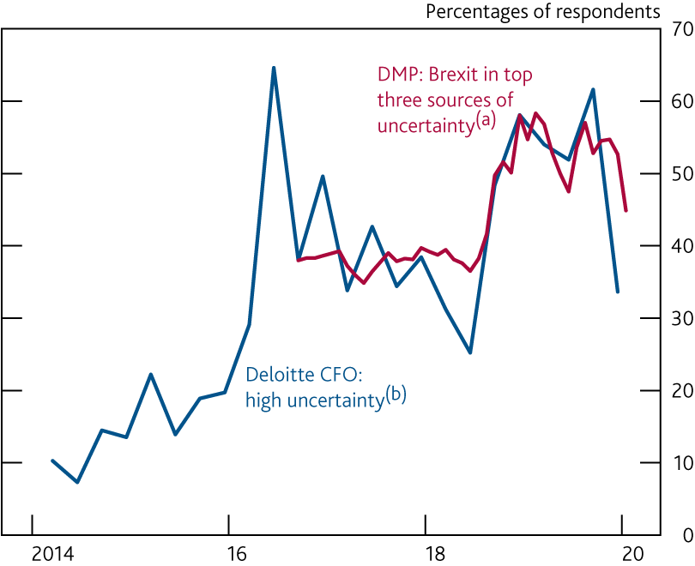
  Chart 2.17 Brexit‑related uncertainty has fallen back a little but remains elevated
    Brexit in top three current sources of uncertainty and CFOs reporting high uncertainty
Sources: Decision Maker Panel (DMP) Survey, Deloitte and Bank calculations.
Question: ‘How much has the result of the EU referendum affected the level of uncertainty affecting your business?’. Respondents can select: ‘Not important’; ‘One of many sources’; ‘Two or three top sources’; or ‘Top source of uncertainty’. Before August 2018, data are interpolated between waves and shown as three‑month rolling averages. The DMP currently consists of around 8,000 businesses with around 3,000 responses a month being received. The sample period for the January DMP was 3 to 17 January.
Question: ‘How would you rate the general level of external financial and economic uncertainty facing your business?’. Series shows the proportion of respondents which selected ‘high’ or ‘very high’. Not seasonally adjusted. 119 CFOs responded to the 2019 Q4 survey and the sample period was 16 December to 6 January.

Slide 19
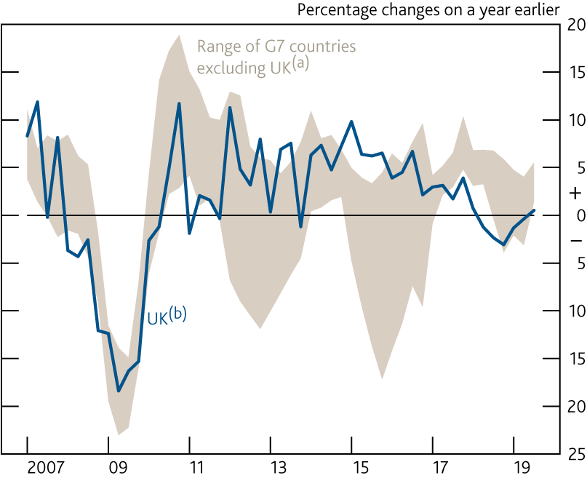
  Chart 2.18 Business investment growth remains weak, despite a slight pickup in the latest data
    G7 business investment
Sources: Eikon from Refinitiv, Japanese Cabinet Office, OECD, ONS, Oxford Economics, Statistics Canada, US Bureau of Economic Analysis and Bank calculations.
Business investment is not an internationally recognised concept. This swathe is based on similar series derived from other countries’ National Accounts. Private sector business investment for Italy. Business investment minus residential structures for Canada. Non‑residential private investment for Japan and the US. Non‑government investment minus dwellings investment for France and Germany.
Chained-volume measure.

Slide 20
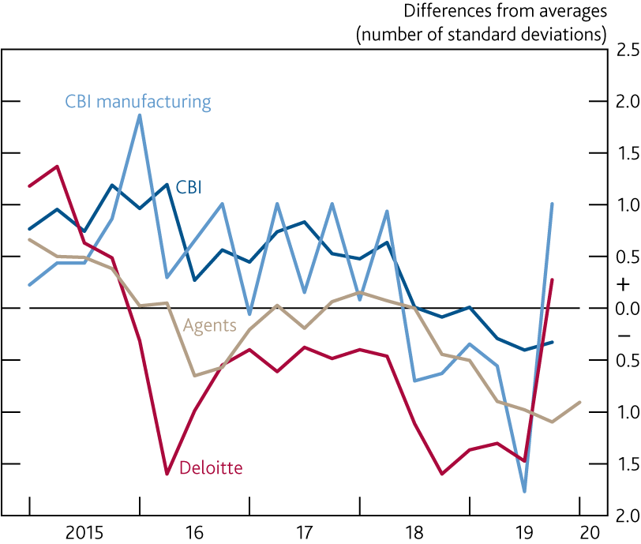
  Chart 2.19 Investment intentions have been subdued, but some surveys suggest they have picked up in the latest data
    Selected survey indicators of investment intentions^{(a)}
Sources: Bank of England, CBI, CBI/PwC, Deloitte and Bank calculations.
Differences from averages since 2000 or earliest available data. The Agents’ scores for 2020 Q1 are January scores and were collected in the six weeks to 8 January. The sectors within CBI (manufacturing, distribution, financial services and business/consumer/professional services) are weighted together using shares in real business investment and show planned investment in plant and machinery. The survey periods for 2019 Q4 CBI data were 16 December to 13 January for manufacturing and before the general election for other sectors. Deloitte data (expected changes in capital expenditure) are available from 2010 Q3. The sample period for the 2019 Q4 Deloitte data was 16 December to 6 January.

Slide 21
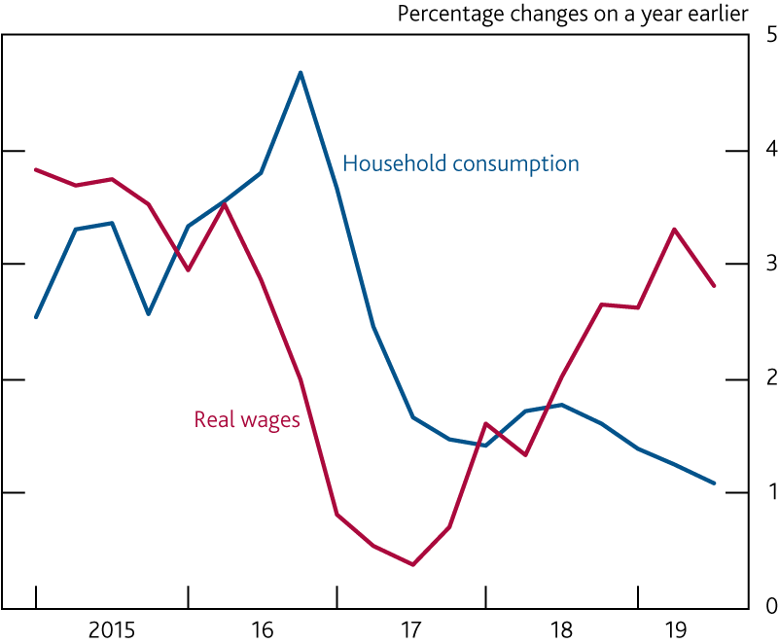
  Chart 2.20 Consumption growth has been weaker than real wage growth, suggesting households may have been cautious about spending
    Household consumption and real wages^{(a)}
Sources: ONS and Bank calculations.
Real wages are whole‑economy real average weekly earnings (excluding bonuses) multiplied by whole‑economy employment.

Slide 22
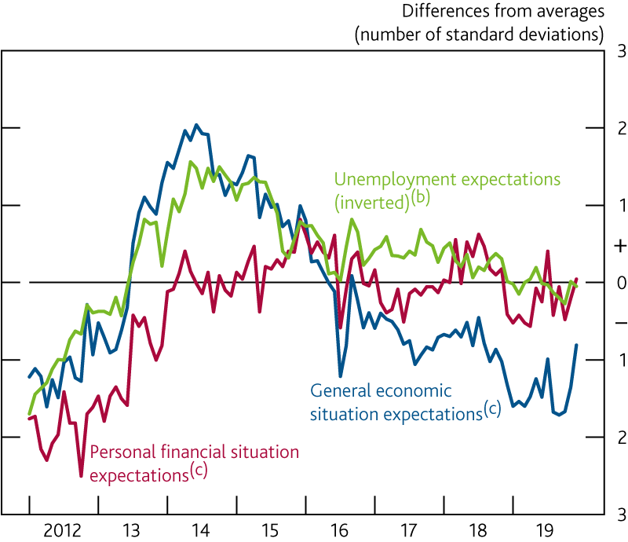
  Chart 2.21 Household confidence has picked up a little since the November Report
    Indicators of consumer confidence^{(a)}
Sources: GfK (research carried out on behalf of the European Commission) and Bank calculations.
Differences from averages since 1997. The December 2019 sample period was 2–11 December.
Net balance of respondents expecting that the number of people unemployed will rise over the next 12 months.
Net balances of respondents expecting an improvement over the next 12 months.

Slide 23
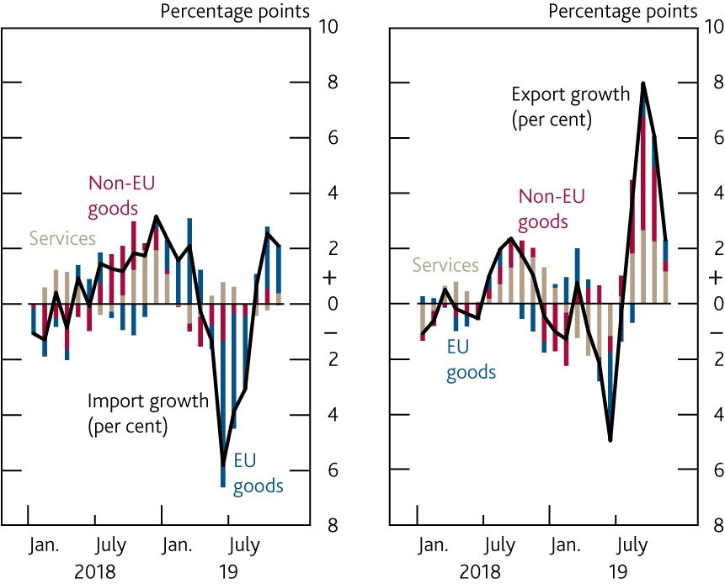
  Chart 2.22 Trade data have been volatile
    Contributions to three‑month on three‑month growth in imports and exports, by type^{(a)}
Sources: ONS and Bank calculations.
Chained‑volume measures. Goods exports and imports are measured excluding trade in unspecified goods.

Slide 24
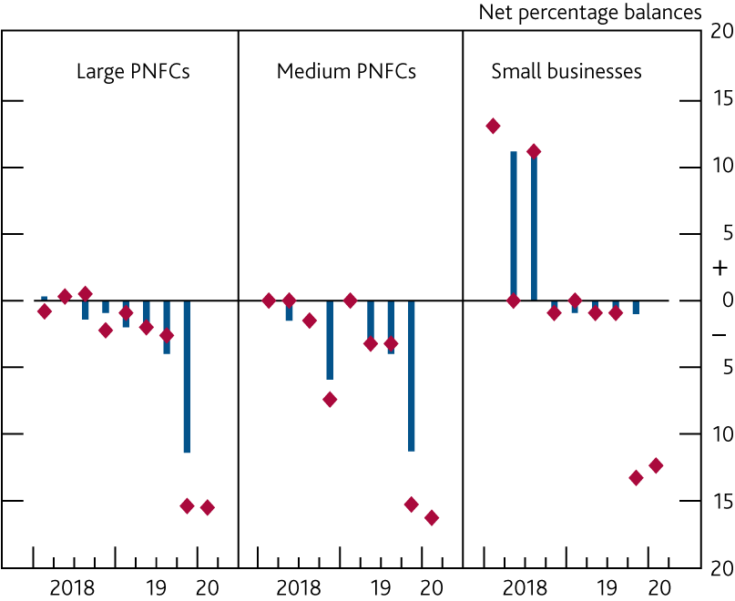
  Chart 2.23 Corporate credit conditions tightened in Q4
    Availability of credit to corporates reported by lenders in the Credit Conditions Survey^{(a)}
Weighted by market shares. A positive balance indicates that more credit is available. Diamonds show net percentage balances for the expected change over the next three months, these have been moved forward by one quarter so that they can be compared with the actual outcomes in the following quarter.

Slide 25
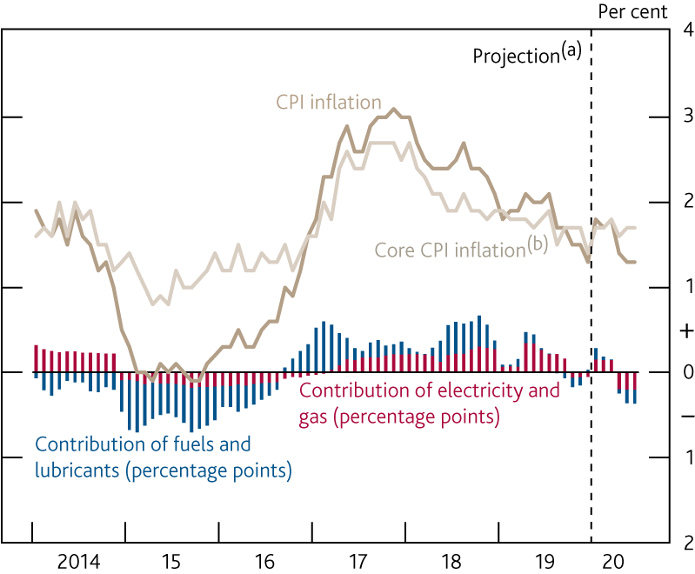
  Chart 2.24 The fall in inflation over 2019 has been driven largely by energy prices
    CPI inflation, core CPI inflation and the contribution of energy
Sources: Bloomberg Finance L.P., Department for Business, Energy and Industrial Strategy, ONS and Bank calculations.
Bank staff’s projection. Fuels and lubricants estimates use Department for Business, Energy and Industrial Strategy petrol price data for January 2020 and are then based on the sterling oil futures curve.
CPI inflation excluding food, energy, alcohol, tobacco and non‑alcoholic beverages.

Slide 26
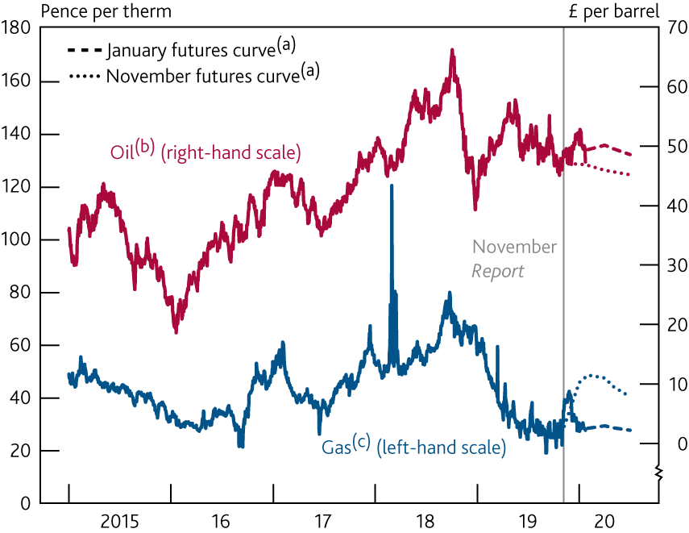
  Chart 2.25 Oil prices have increased since the November Report
    Sterling oil and wholesale gas prices
Sources: Bank of England, Bloomberg Finance L.P. and Bank calculations.
Fifteen working day averages to 22 January 2020 and 30 October 2019 respectively.
US dollar forward prices for delivery in 10–25 days’ time converted into sterling.
One‑day forward price of UK natural gas.

Slide 27
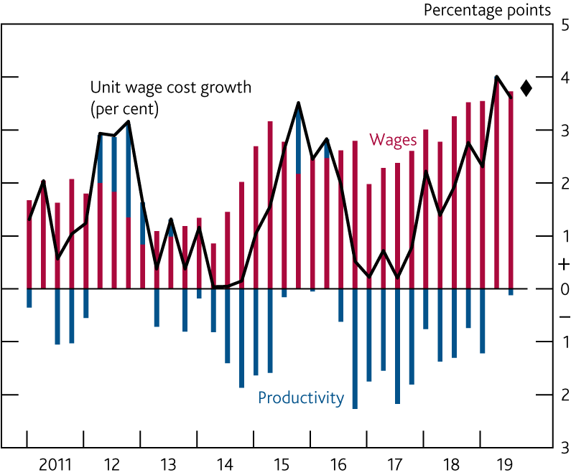
  Chart 2.26 Unit wage cost growth has risen over 2019
    Contributions to four‑quarter private sector unit wage cost growth^{(a)}
Sources: ONS and Bank calculations.
Private sector AWE regular pay divided by private sector productivity per head, based on the backcast for the final estimate of private sector output. See Table 4.C in the November 2018 Inflation Report for more details on measures of unit labour costs. Diamond shows Bank staff’s projection for 2019 Q4 based on data to November.

Slide 28
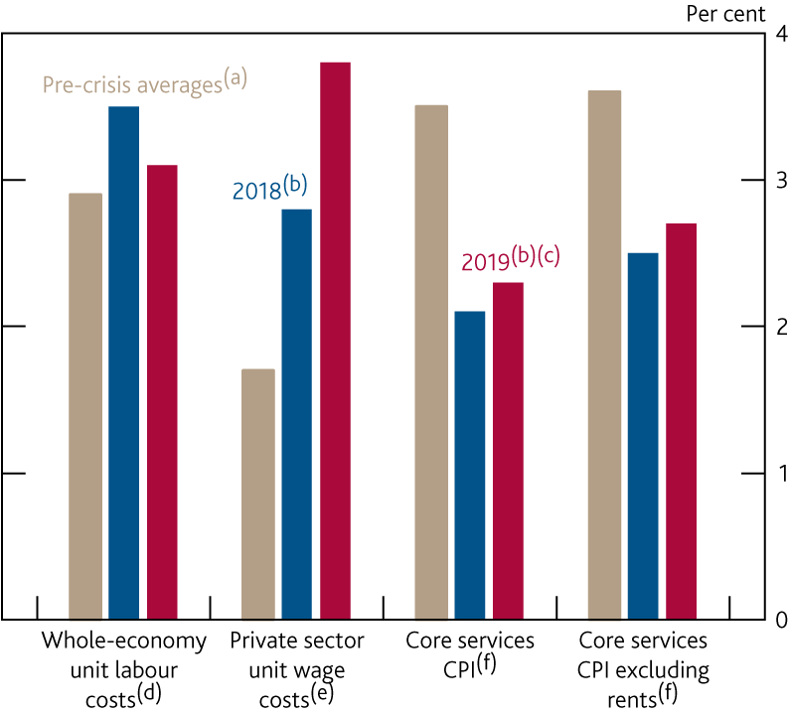
  Chart 2.27 Labour cost-based measures of domestic price pressures remain stronger than CPI‑based measures
    Four‑quarter growth in measures of domestically generated inflation
Sources: Sources: ONS and Bank calculations.
(a) Pre‑crisis averages are the average of four‑quarter growth rates over 1998–2007. Data for private sector regular pay growth is only available from 2000, so the pre-crisis average growth rate is calculated over 2001–07.
(b) Figures for 2018 and 2019 are the four‑quarter growth rates in 2018 Q4 and 2019 Q4 respectively.
(c) 2019 figures for whole‑economy unit labour costs and private sector unit wage costs are Bank staff’s estimates based on data to November.
(d) Whole‑economy total labour costs divided by real GDP, based on the mode of the MPC’s backcast. Total labour costs comprise compensation of employees and the labour share multiplied by mixed income.
(e) See footnote (a) of Chart 2.26.
(f) Core services CPI inflation excludes airfares, package holidays, education and an estimate of the impact of changes in VAT.

Slide 29
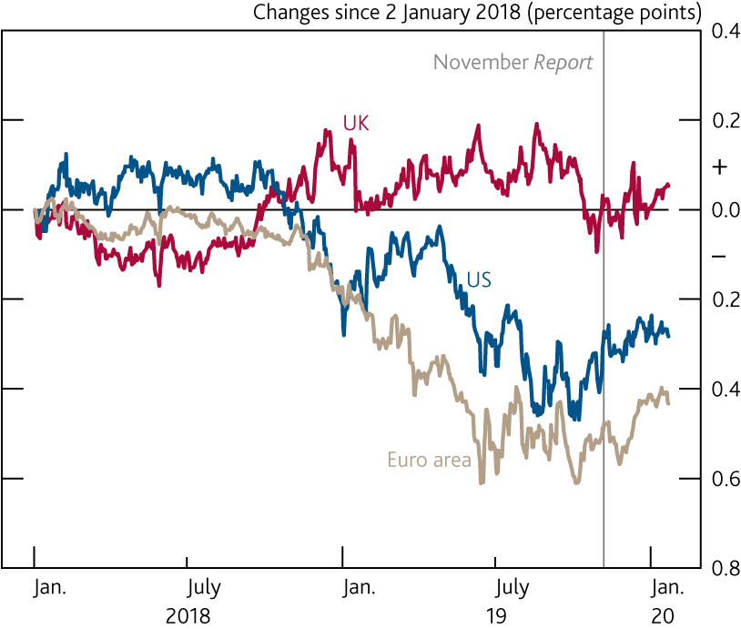
  Chart 2.28 Implied inflation expectations in the US and euro area have fallen over the past year
    Changes in five‑year, five‑year forward inflation compensation^{(a)}
Sources: Bloomberg Finance L.P. and Bank calculations.
(a) Derived from swaps. The instruments are linked to the UK RPI, US CPI and euro‑area HICP measures of inflation respectively.

Slide 30
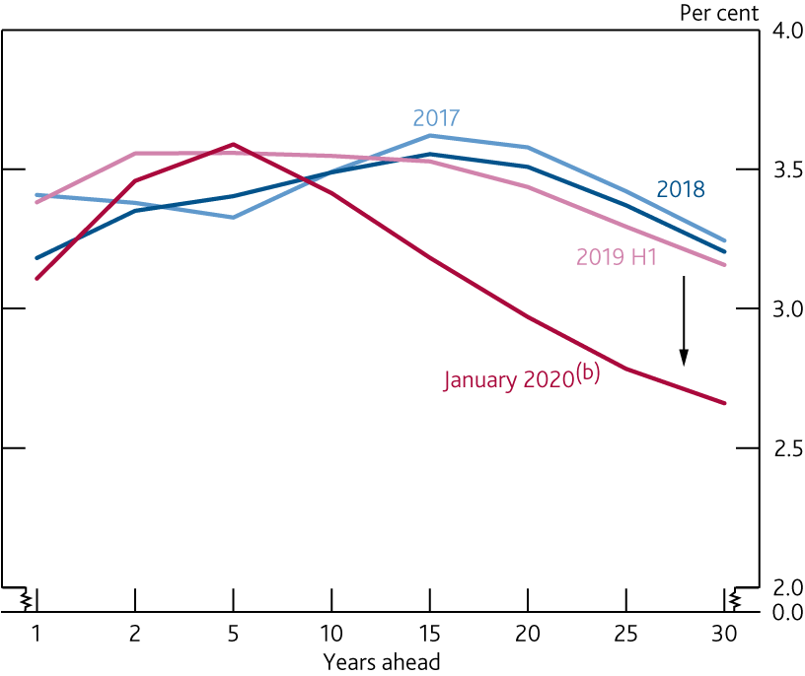
  Chart 2.29 The UK inflation swap curve has inverted
    Implied expectations of RPI inflation from swaps^{(a)}
Sources: Bloomberg Finance L.P. and Bank calculations.
(a) Instantaneous RPI inflation expectations implied by swaps.
(b) January 2020 is an average to 22 January 2020.

Slide 31
Tables

Slide 32
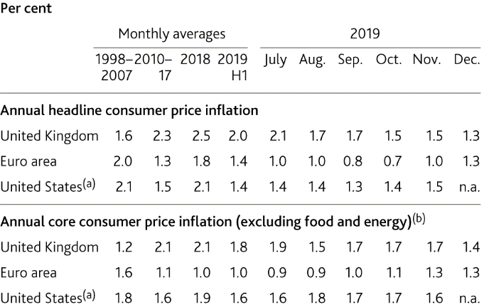
  Table 2.A Inflation has been particularly weak in the euro area
    Inflation in selected economies
Sources: Eikon from Refinitiv, Eurostat, US Bureau of Economic Analysis and Bank calculations.
(a) Personal consumption expenditure price index inflation.
(b) For the euro area and the UK, excludes energy, food, alcoholic beverages and tobacco. For the US, excludes food and energy.

Slide 33
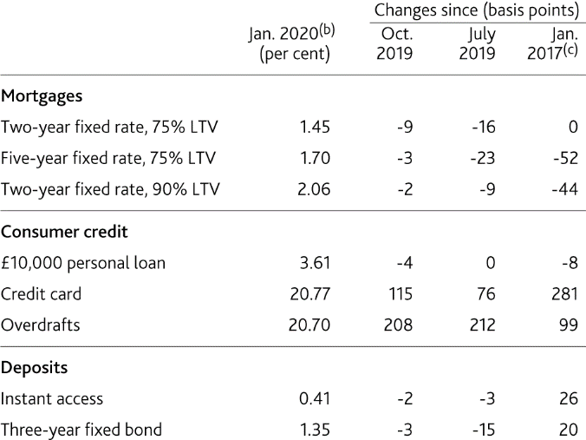
  Table 2.B Mortgage rates remain low
    Selected household lending and deposit quoted rates^{(a)}
(a) The Bank’s quoted rate series are weighted monthly average rates advertised by all UK banks and building societies with products meeting the specific criteria. Not seasonally adjusted.
(b) January 2020 data are flash estimates using data to 22 January and are subject to change until they are published on 7 February.
(c) In February 2019 the method used to calculate these data was changed. See ‘Introduction of new Quoted Rates data’ for more information.

Slide 34
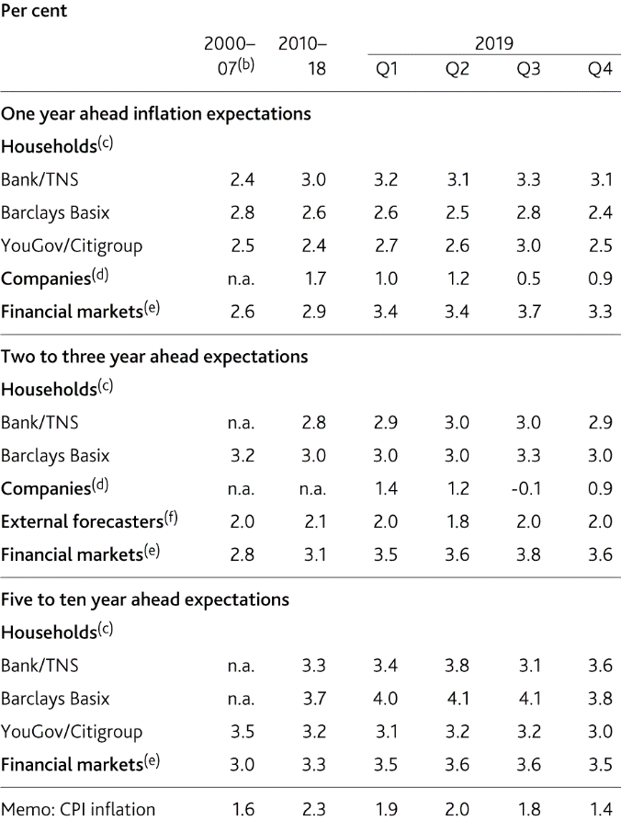
  Table 2.C Inflation expectations remain well anchored
    Measures of inflation expectations^{(a)}
Sources: Bank of England, Barclays Capital, Bloomberg Finance L.P., CBI, Citigroup, ONS, TNS, YouGov and Bank calculations.
(a) Data are not seasonally adjusted.
(b) Averages from 2000, or start of series, to 2007. Financial market data start in October 2004, YouGov/Citigroup data start in November 2005 and professional forecasters data start in 2006 Q2.
(c) The household surveys ask about expected changes in prices but do not reference a specific price index. The measures are based on the median estimated price change.
(d) CBI data for the distributive trades sector. Companies are asked about the expected percentage price change over the coming 12 months and the following 12 months in the markets in which they compete.
(e) Instantaneous RPI inflation one and three years ahead and five‑year RPI inflation five years ahead, implied from swaps.
(f) Bank’s survey of external forecasters, CPI inflation rate three years ahead.

Slide 35
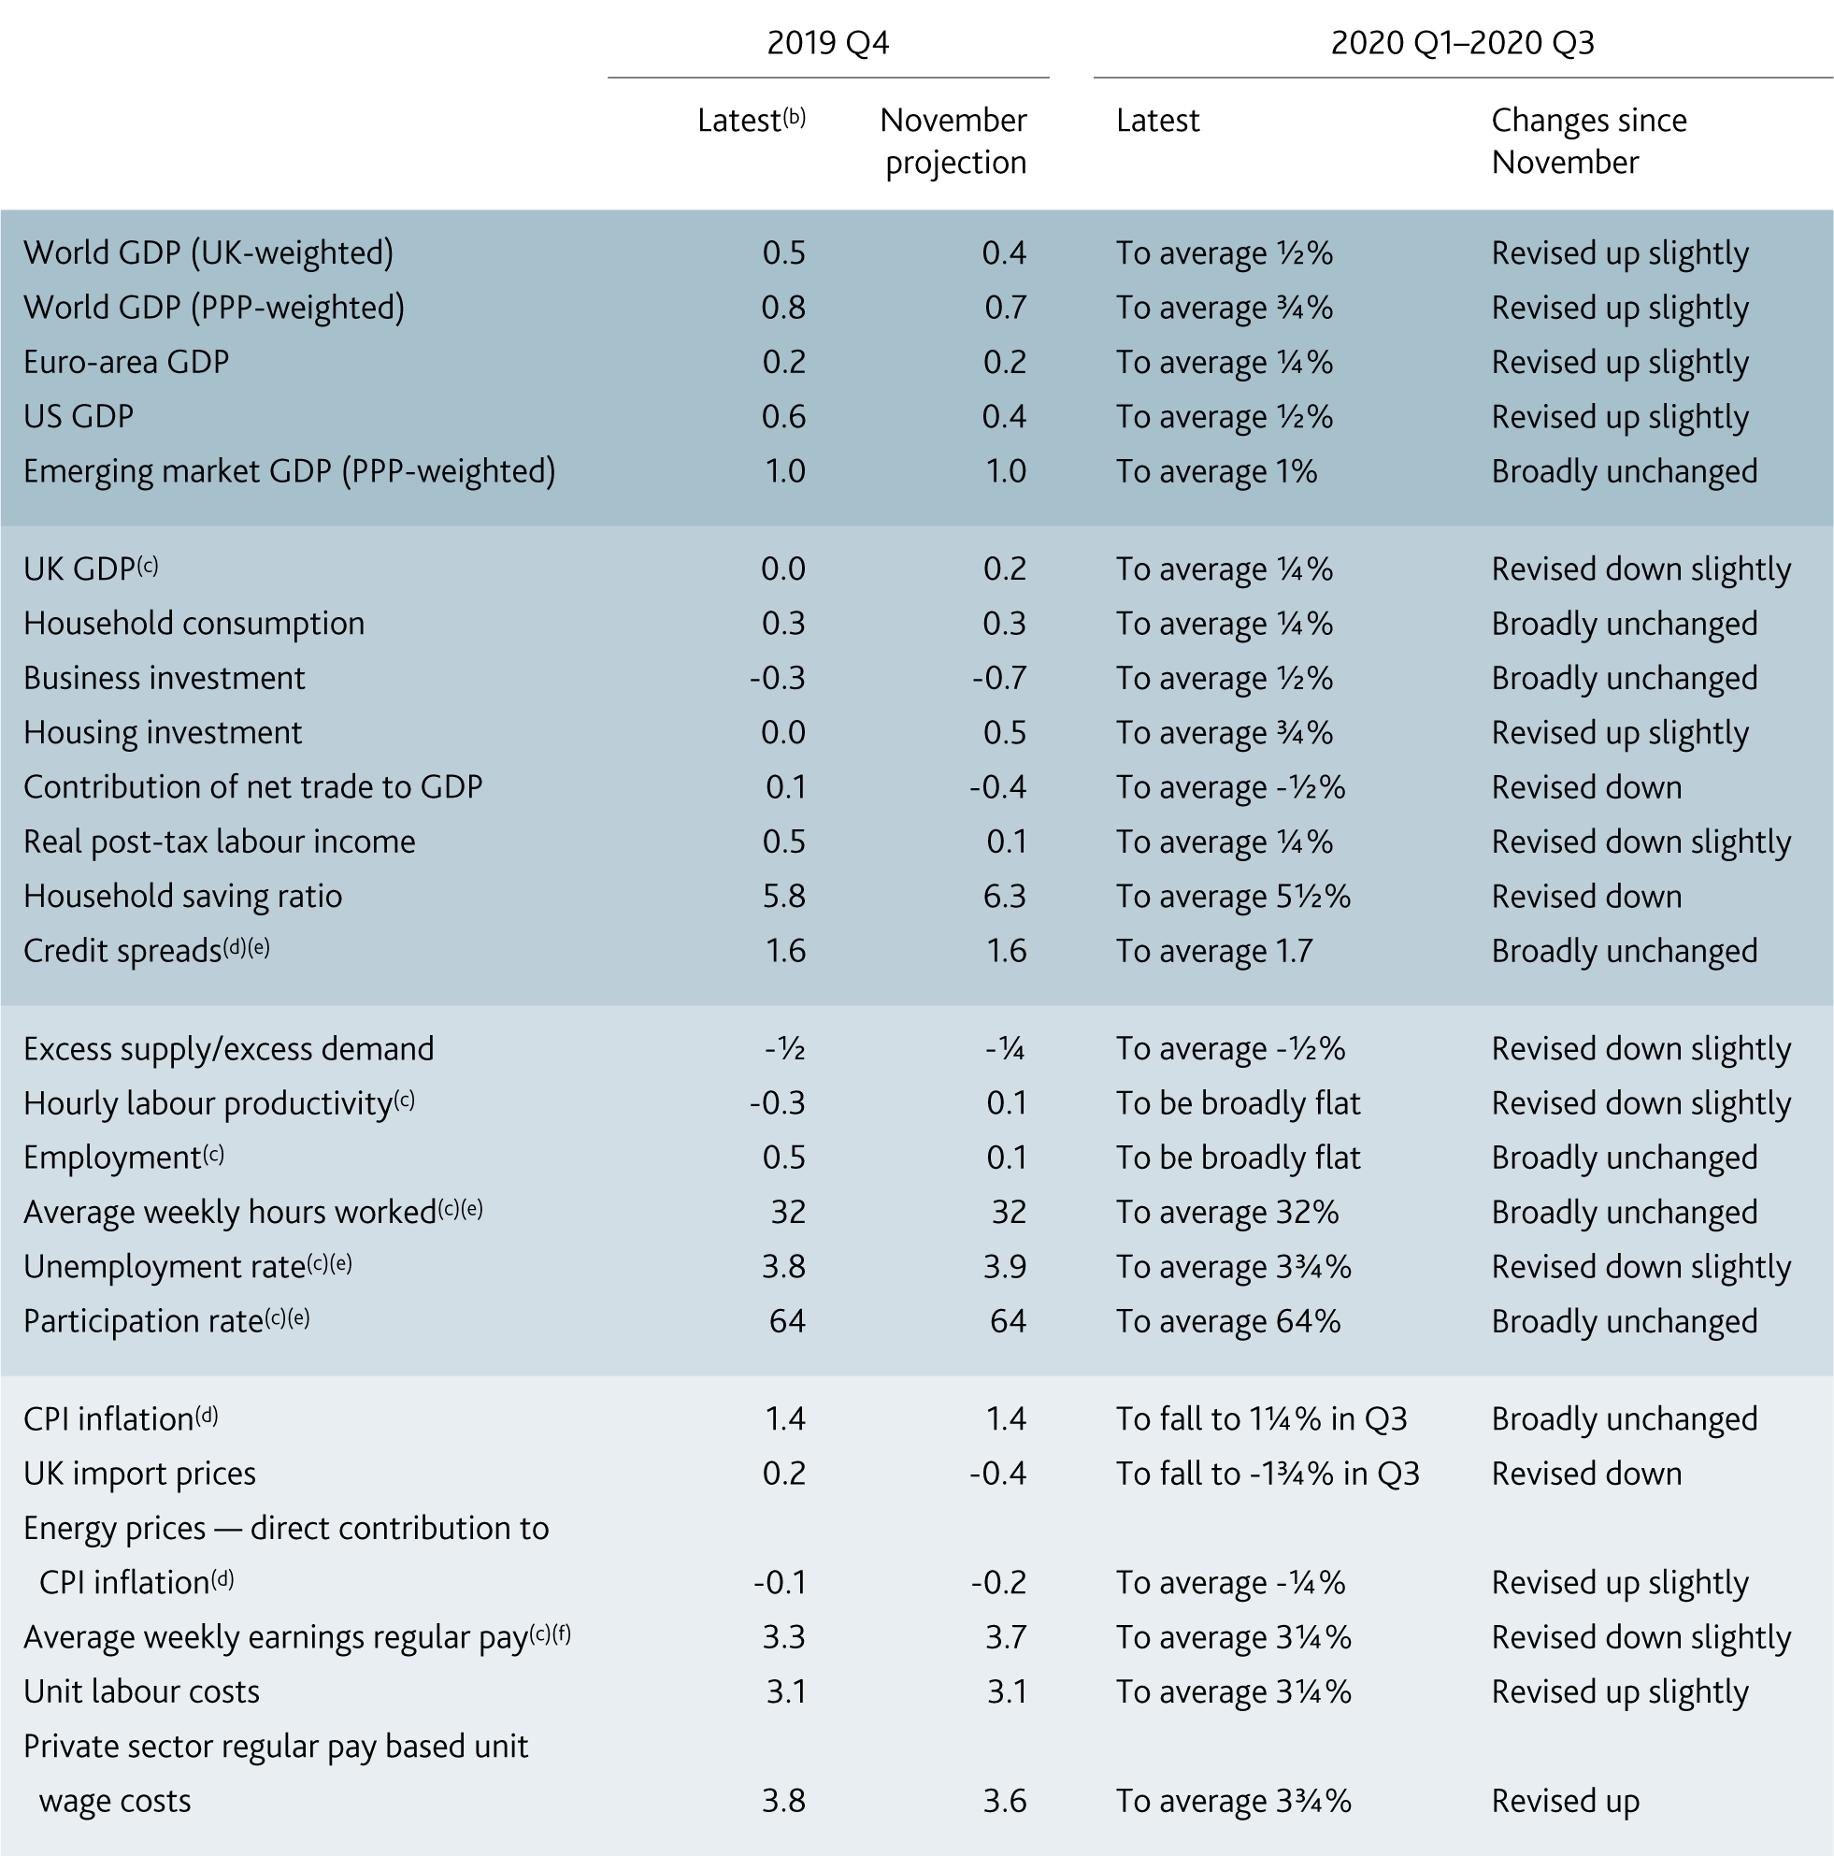
  Table 2.D Monitoring the near-term outlook^{(a)}
Sources: Bank of England, Bloomberg Finance L.P., Department for Business, Energy and Industrial Strategy, Eurostat, IMF World Economic Outlook (WEO), ONS, US Bureau of Economic Analysis and Bank calculations.
(a) Definitions of underlying series are as given in footnotes of Table 1.C in Section 1, unless otherwise stated. Figures show quarterly growth rates unless otherwise stated. All price and wage measures are four‑quarter growth rates.
(b) Data are projections unless otherwise stated.
(c) Projections based on official data to November 2019.
(d) 2019 Q4 data are outturns.
(e) Quarterly level.
(f) Whole-economy regular pay. Growth rates based on KAI7.

Slide 36
Box 2
Agents’ update on business conditions

Slide 37
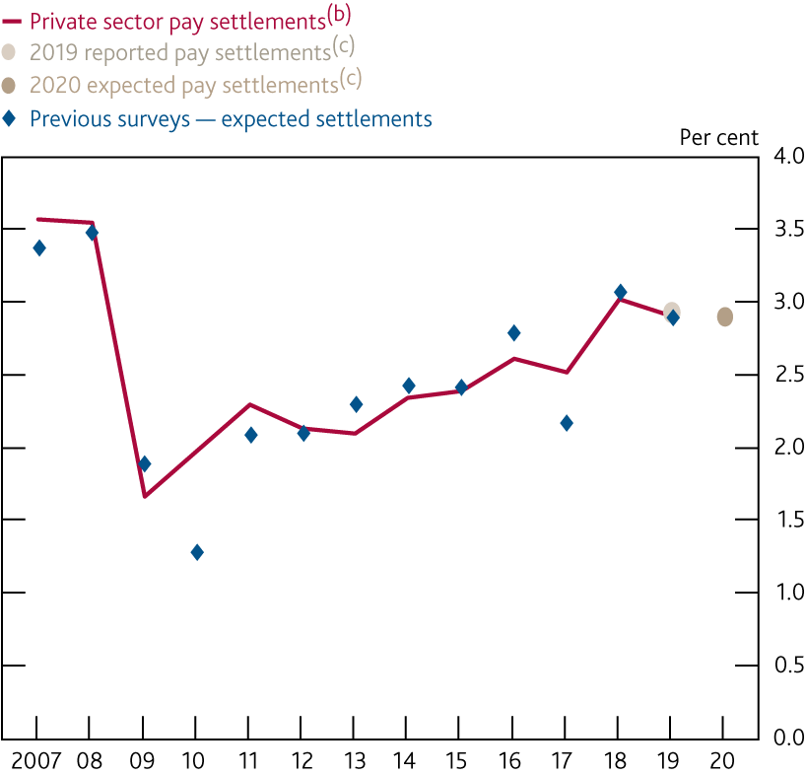
  Chart A Pay settlements are expected to be the same in 2020 as in 2019
    Pay settlements^{(a)}
Sources: Bank of England, including the wage settlements database (which draws on information from the Bank’s Agents, Incomes Data Research, Incomes Data Services, Industrial Relations Services and the Labour Research Department) and Bank calculations.
(a) Companies were asked to state their average UK pay settlement for 2019 and their expected average UK pay settlement for 2020.
(b) Average over the past 12 months, based on monthly data.
(c) Data gathered from the 2020 Agents’ Pay Survey.

Slide 38
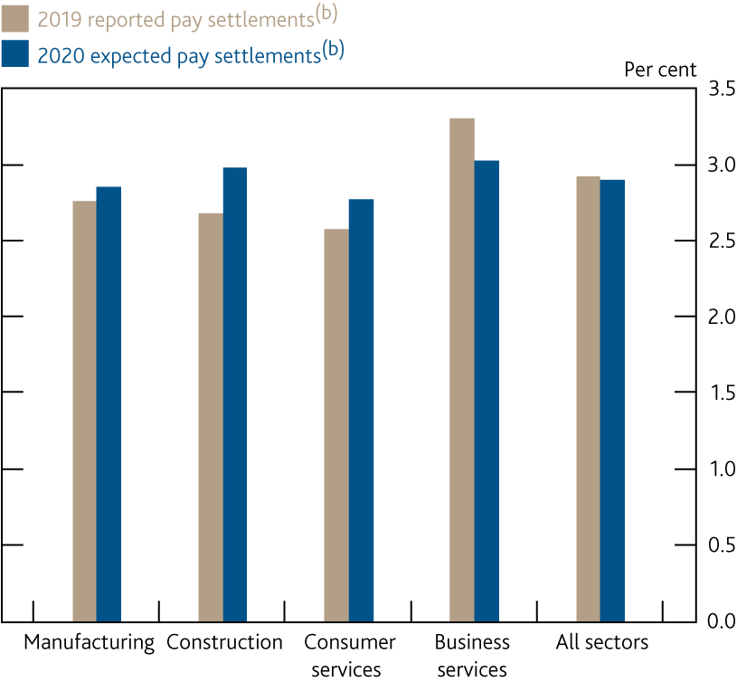
  Chart B Pay settlements in 2020 are expected to be similar across sectors
    Pay settlements by sector^{(a)}
(a) Companies were asked to state their average UK pay settlement for 2019 and their expected average UK pay settlement for 2020.
(b) Data gathered from the 2020 Agents’ Pay Survey.

Slide 39
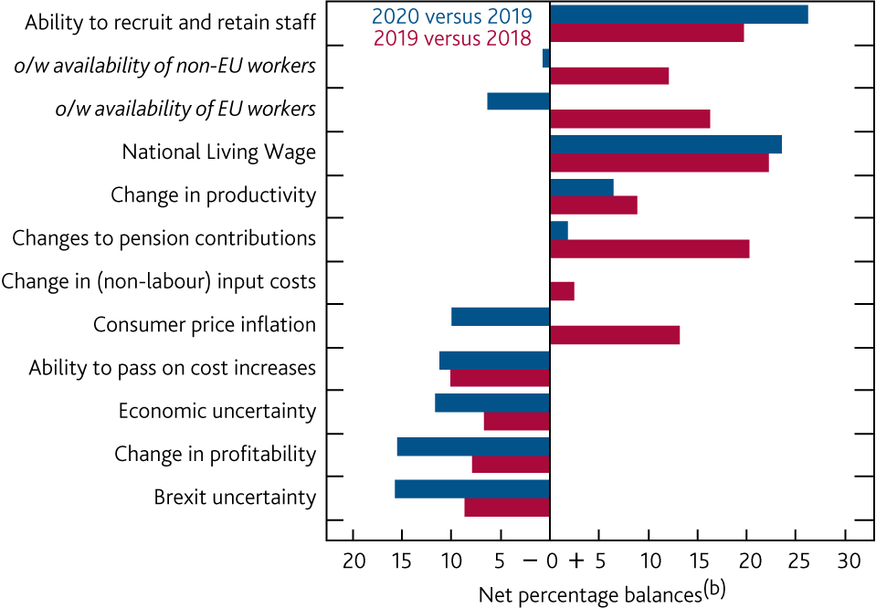
  Chart C The factors driving changes in total labour cost growth in 2020 are broadly similar to 2019
    Factors driving the change in the rate of expected TLC growth^{(a)}
(a) Companies were asked: ‘How do you expect the following factors to affect the rate of growth in total labour costs per employee in 2020 compared with the rate of growth in 2019?’.
(b) Respondents were asked to choose between ‘Much slower’; ‘A little slower’; ‘The same’; ‘A little faster’ and ‘Much faster’. To calculate these net balances, the following estimates were assumed for each response bucket: -1 for the ‘Much slower’ response category; -0.5 for the ‘A little slower’ response category; 0 for ‘The same’ response category; +0.5 for ‘A little faster’; and +1 for ‘Much faster’.

